Slide 1
SENTIMENTAL ANALYSIS USING AMAZON REVIEW DATASET
Student Name
SAKTHIVEL.C
Roll No:21BIT137
Department of IT
The American College
12.04.2024

Slide 2
CONTENTS
1.Introduction
1.1Abstract
2.System Analysis
2.1 Existing System
2.2 Proposed System
3. System Requirements
3.1 Software requirements
3.2 Hardware requirements
4. Module description
5. System Design
5.1 Data flow diagram
5.2 Database design
6. System Implementation
7. System Testing
8. Conclusion
9. Future Enhancement

Slide 3
1. Introduction
Amazon is one of the earliest and most successful online retail platforms, pioneering the concept of selling goods over the internet. Operating in numerous countries, Amazon has a global reach that enables consumers worldwide to access a wide range of products and services.

Slide 4
1.1 Abstract
As now a day’s people are relying on online products so
the importance of a review is going higher. For selecting a
product, a customer needs to go through thousands of reviews to
understand a product. But in this prospering day of machine
learning, going through thousands of reviews would be much
easier if a model is used to polarize those reviews and learn from
it.

Slide 5
2. System Analysis
2.1 Existing System
Using BERT (Bidirectional Encoder Representations from Transformers) for sentiment analysis involves leveraging pre-trained BERT models, fine-tuning them on a sentiment analysis dataset, and then using the fine-tuned model for making sentiment predictions on new text data.
2.2 Proposed System
VADER (Valence Aware Dictionary and sEntiment Reasoner) is a pre-built, lexicon and rule-based sentiment analysis tool. Unlike BERT, which is a deep learning model, VADER relies on a predefined list of words and associated sentiment scores

Slide 6
3. System Requirements
3.1 Software requirements
Programming Language: PYTHON, R
Natural language processing libraries
Machine learning
Jupyter notebook (IDE)
Visualization (Result)
3.2 Hardware requirements
CPU: Multi-core processor
RAM: 4GB and 8GB+
Storage: A standard hard drive (SDD) and hard disk drive (HDD) with sufficient storage capacity is suitable.

Slide 7
4.Module Description
Importing libraries: First, necessary libraries are imported, including NumPy, Pandas, NLTK, and Vader Sentiment Analyzer
Jupyter Notebook: Jupyter Notebook is opened to write Python code for sentiment analysis
Importing data: The Amazon customer review dataset is imported. Cleaning data: The data is cleaned by removing punctuation and numbers, converting text to lowercase, and splitting the text into individual words.

Slide 8
Module Description
Sentimental analysis: Vader Sentiment Analyzer is used to analyze the sentiment of each review. It returns a polarity score (between -1 and 1) and a subjectivity score (between 0 and 1).
Categorizing reviews: Reviews are categorized as positive, negative, or neutral based on their polarity scores.
Visualization: The distribution of positive, negative, and neutral reviews is visualized using pie charts and bar charts

Slide 9
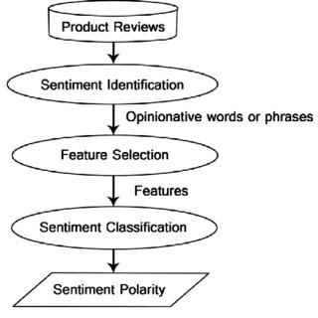
5. System Design 5.1 Data flow diagram level 0

Slide 10
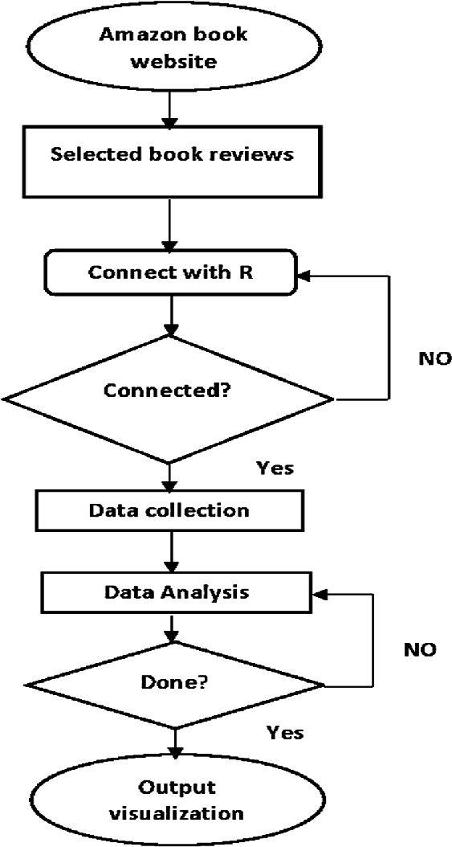
5.2 Data flow diagram level 1

Slide 11
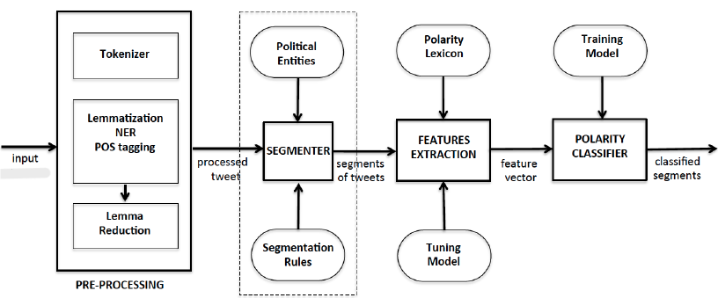
5.3 Data flow diagram level 2

Slide 12
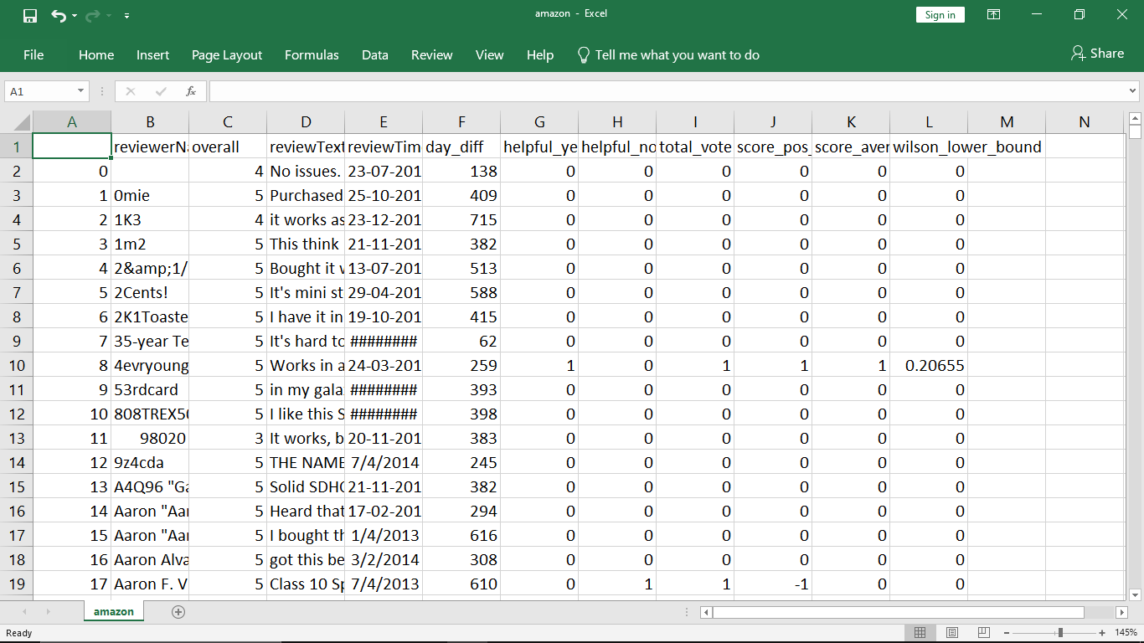
5.2 Data Set Design Structured design for Dataset 1. Avoiding Data Leakage 2. Quality Control 3. Balanced Distribution 4. Well-Labeled Data

Slide 13
6. System Implementation
The VADER (Valence Aware Dictionary and sEntiment Reasoner) model for sentiment analysis on an Amazon review dataset. VADER is particularly useful for analyzing sentiment in short and informal texts, making it well-suited for social media content and user reviews

Slide 14
7. System Testing
An LSTM (Long Short-Term Memory) model is a type of recurrent neural network (RNN) that is particularly well-suited for processing and analyzing sequences of data, making it suitable for tasks like sentiment analysis on textual data. LSTMs are designed to capture long-range dependencies and handle the vanishing gradient problem, which is common in traditional RNNs.

Slide 15
8. Conclusion
By leveraging techniques such as the VADER sentiment analysis model, we have been able to categorize reviews into positive, negative, and neutral sentiments, providing a nuanced understanding of customer feedback.

Slide 16
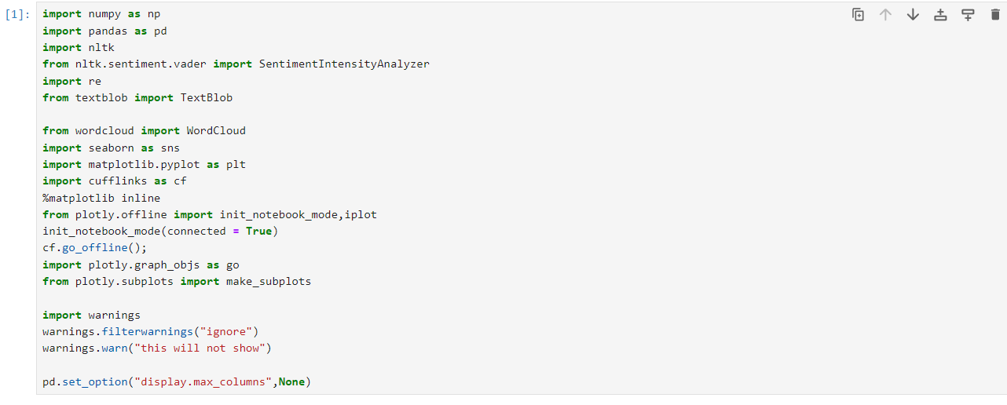
9. Screenshots Importing Libraries

Slide 17

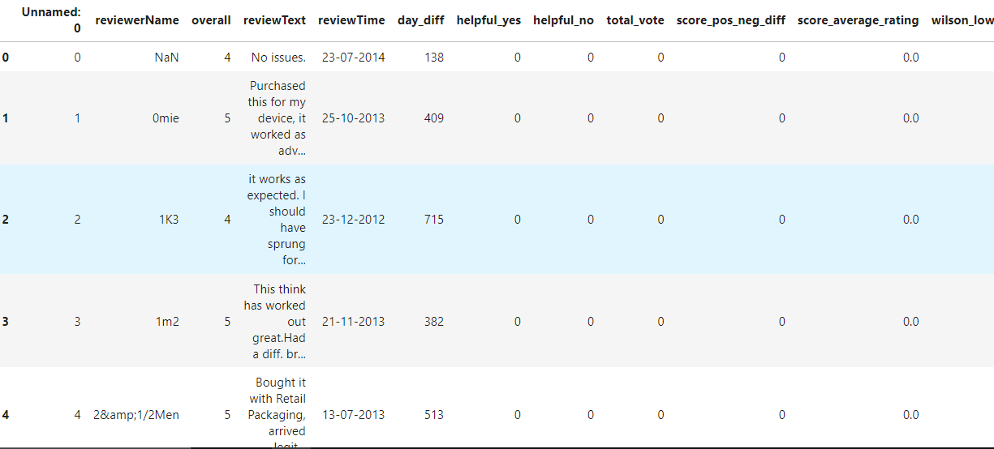
Importing Dataset

Slide 18
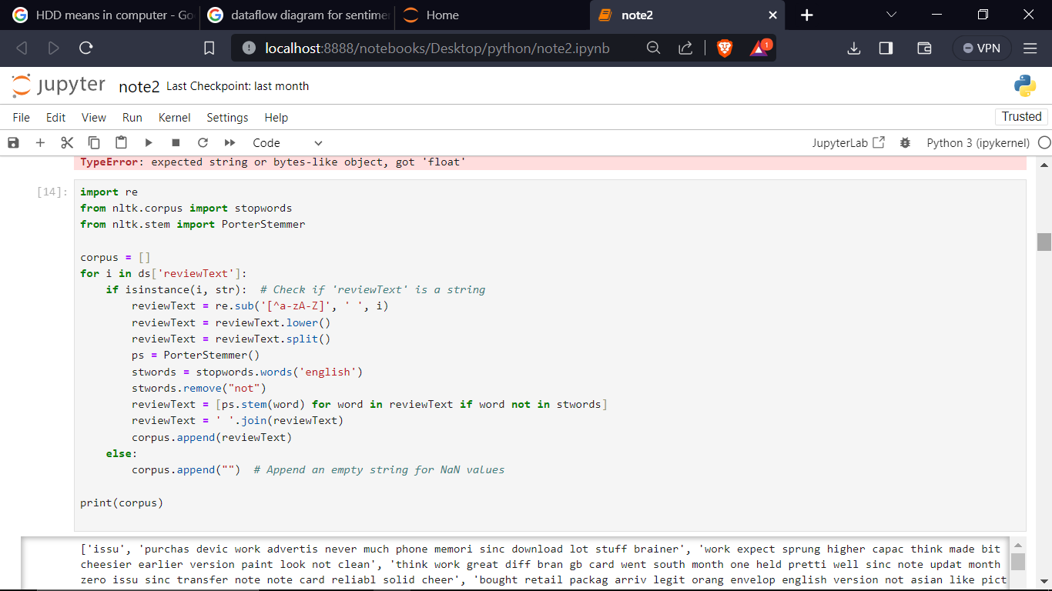
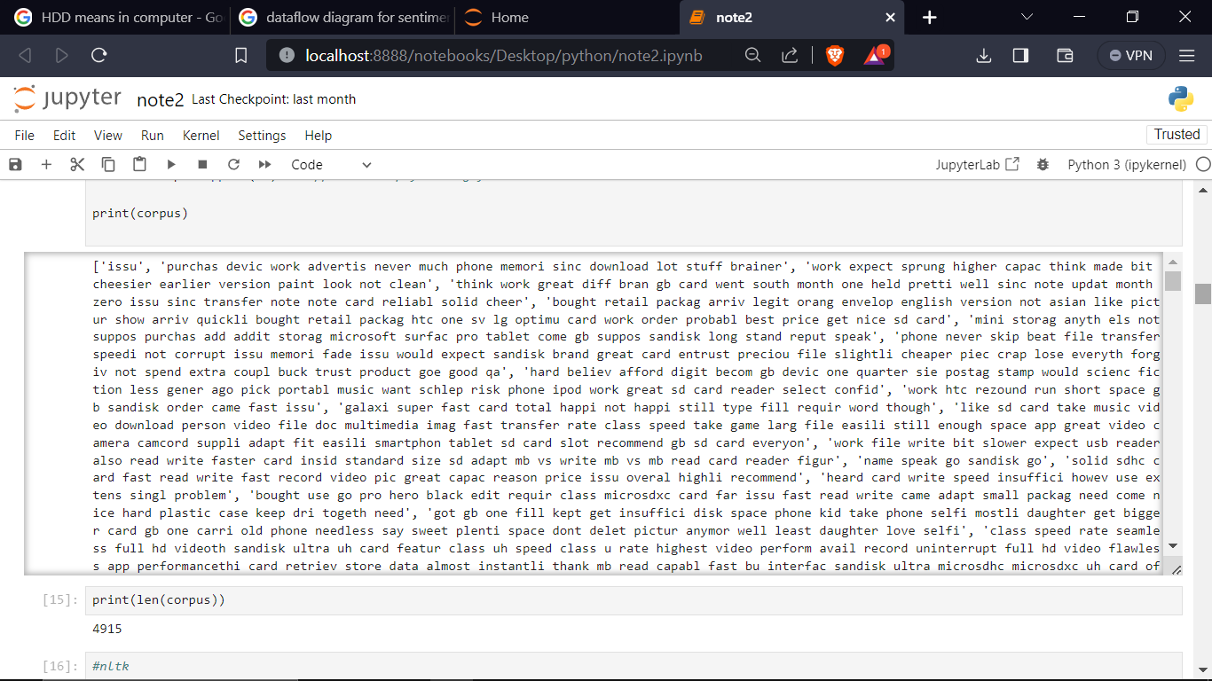
Tokenization

Slide 19
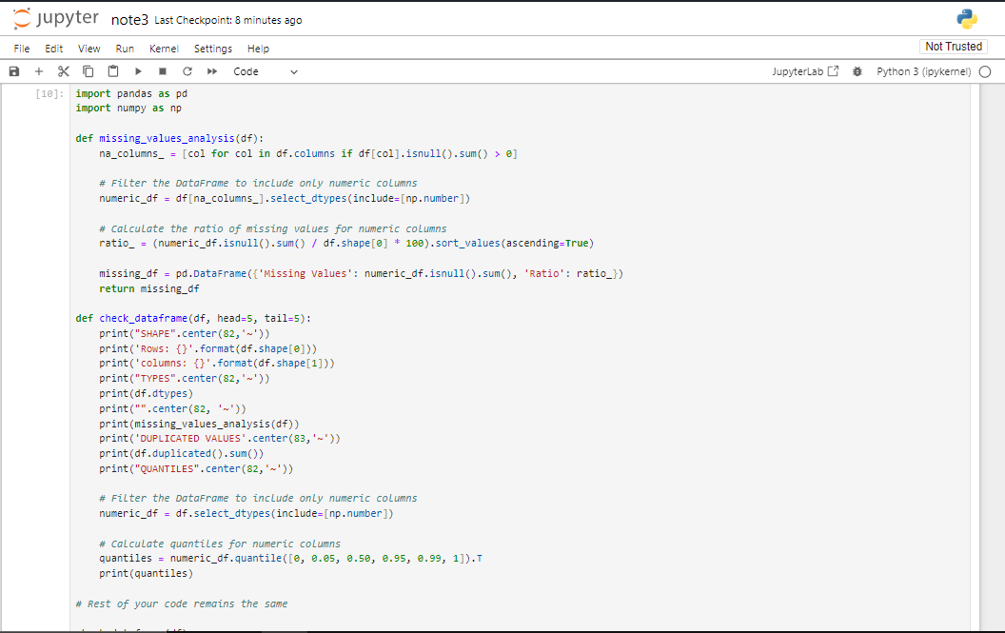
Data Cleaning

Slide 20
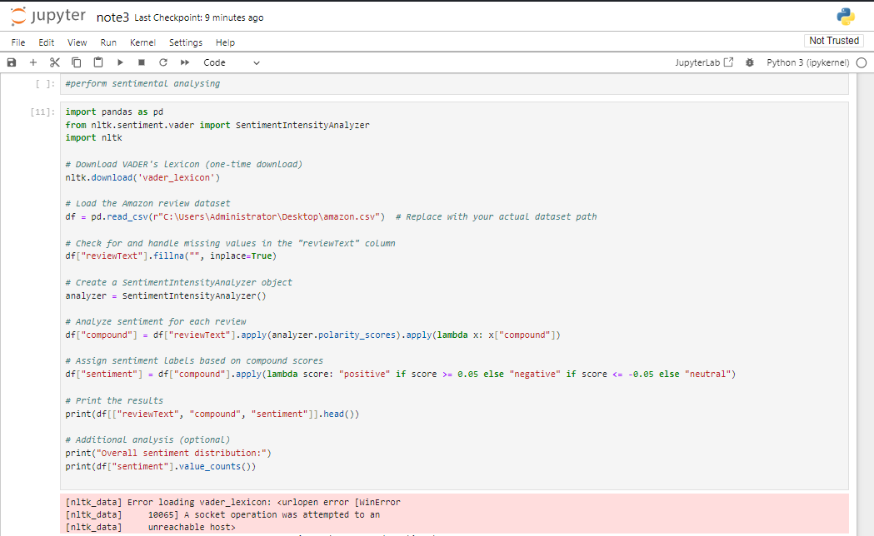
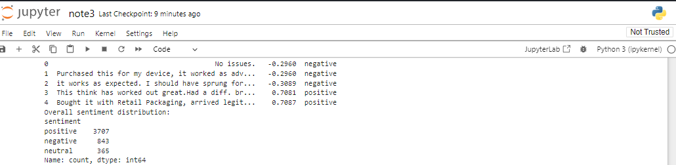
Sentimental analysis

Slide 21
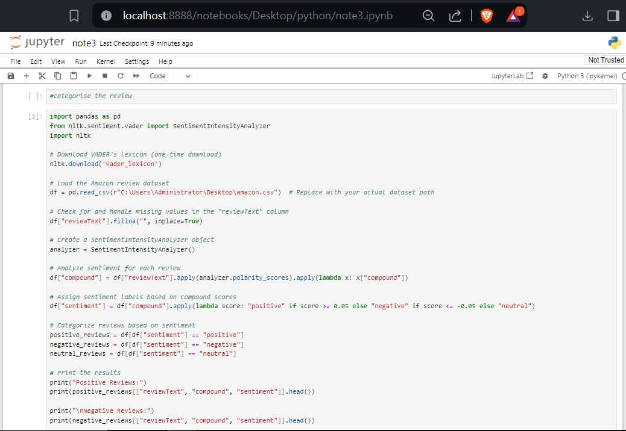
Categories the Review

Slide 22
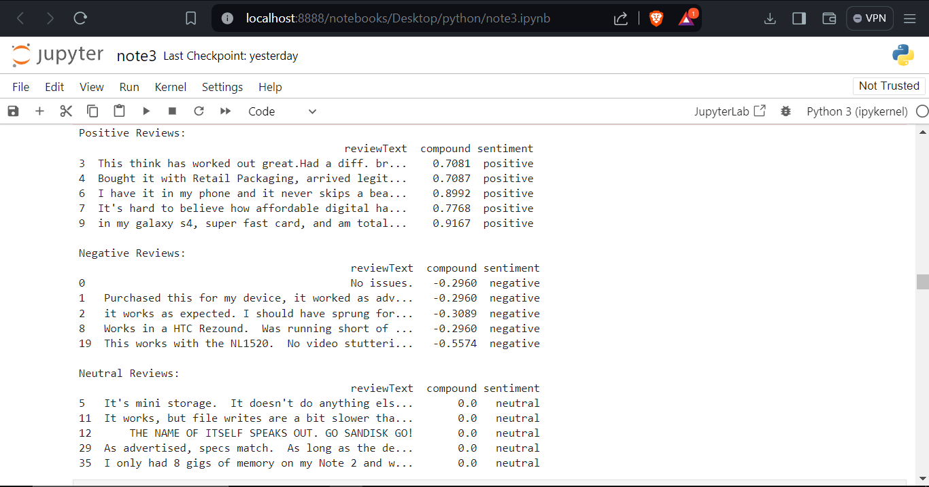
Categorical Review

Slide 23
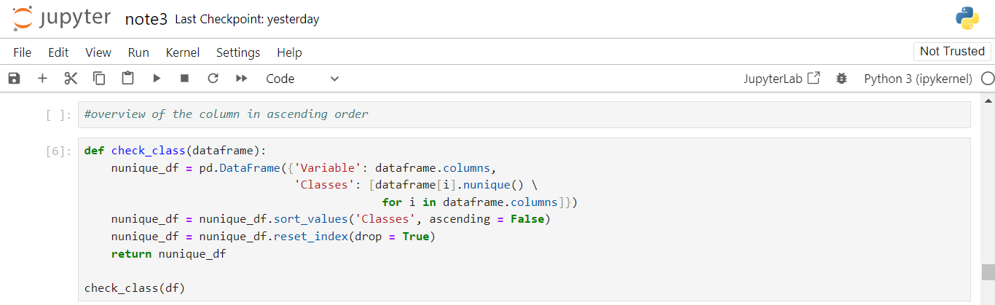
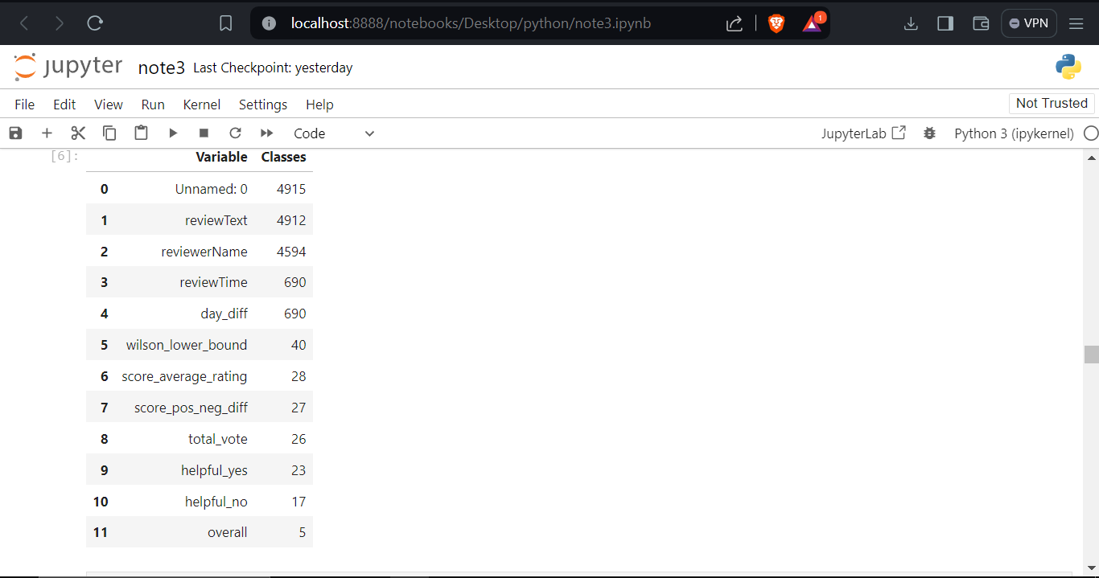
Analyze by column

Slide 24
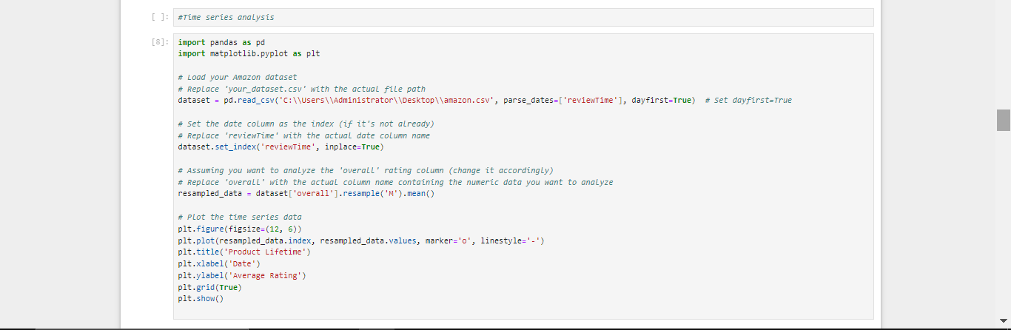
Time series analysis

Slide 25
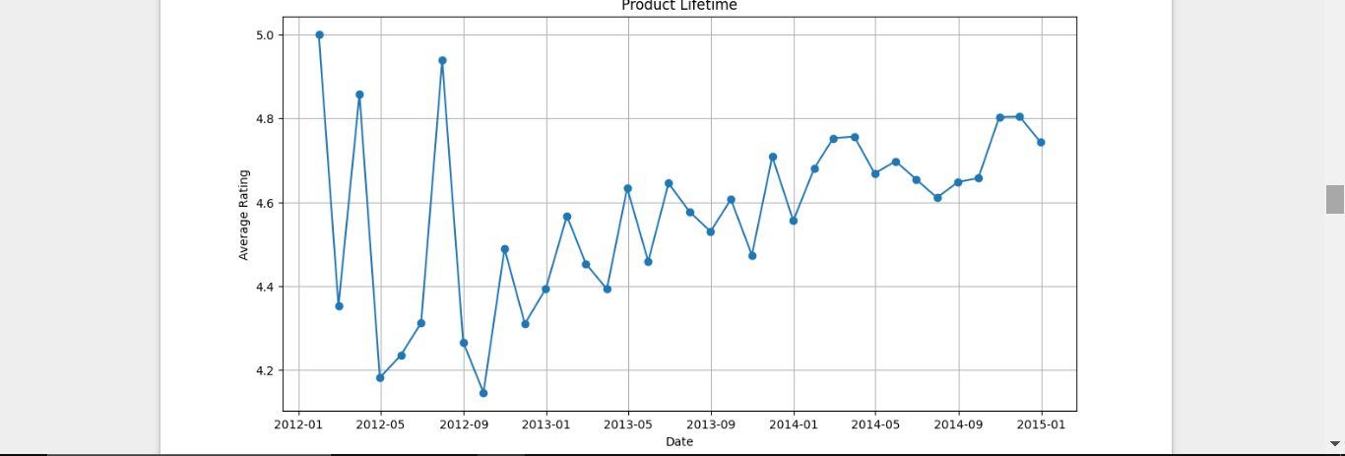
Time series analysis

Slide 26
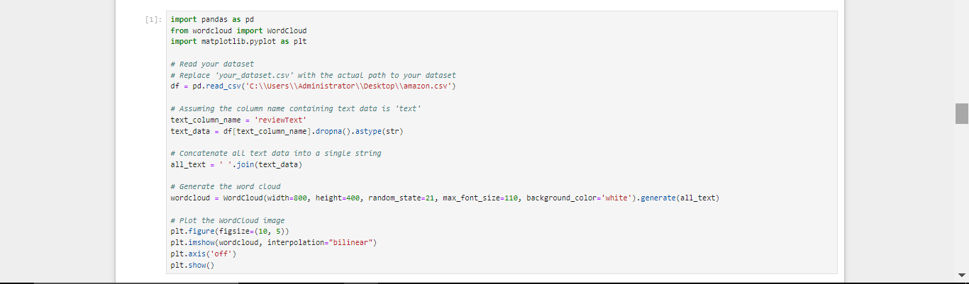
Word cloud

Slide 27
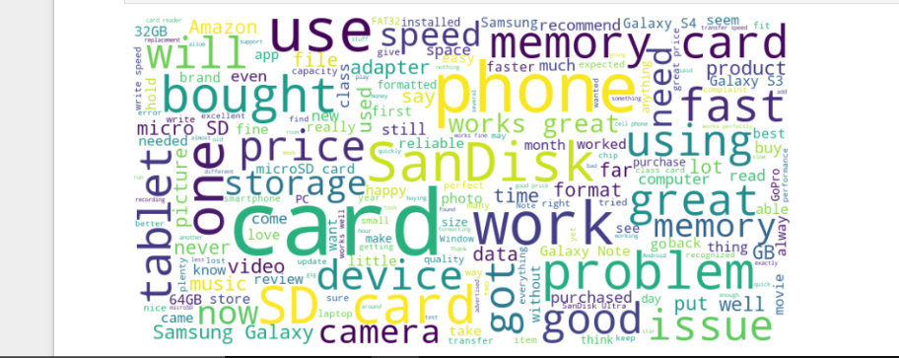
Word cloud

Slide 28
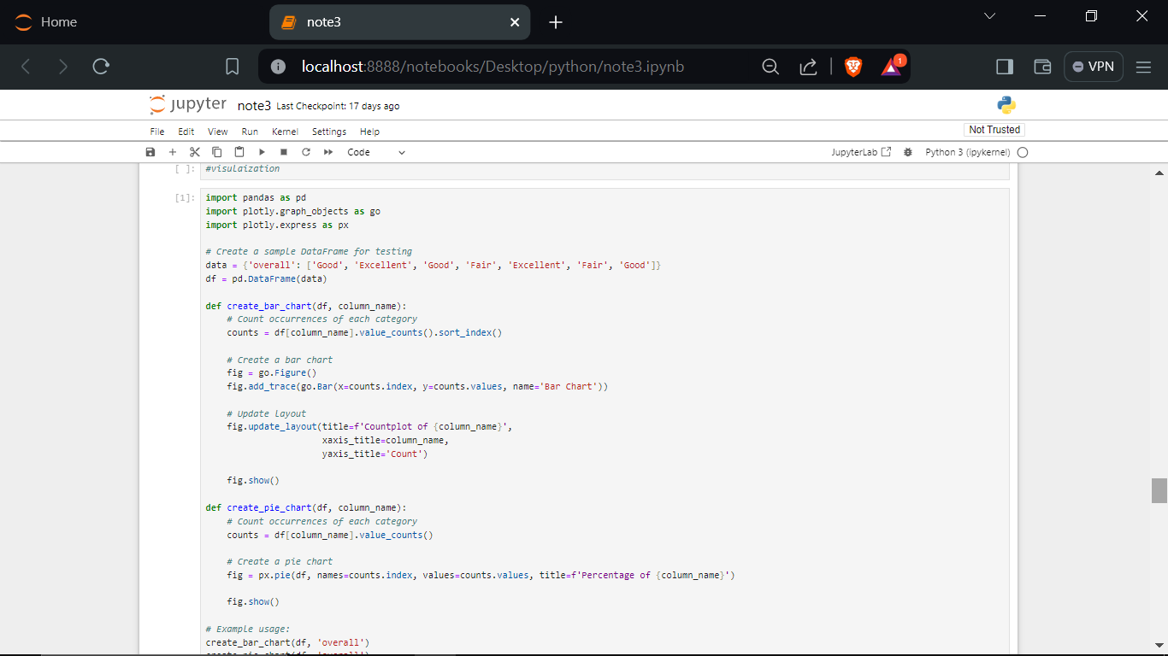
Visualization

Slide 29
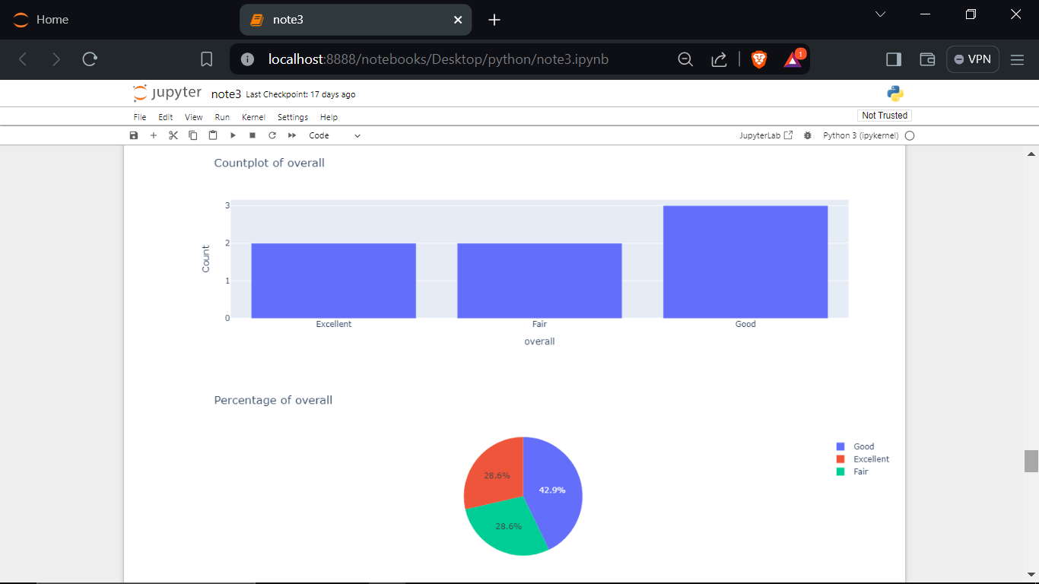
Visualization

Slide 30
THANKYOU

